Slide 1
Artificial Intelligence through the different lens – Cornell University
Bikalpa Neupane, Ph.D. (Penn State)
Director of AI Companion, Takeda Pharmaceuticals
Email: bneupane@fas.harvard.edu
Twitter: @BikalpaN
Disclaimer: The views in this presentation are my own and don't necessarily represent the positions, strategies or opinions of Takeda, IBM, Harvard, and Penn State.
Notes:
Thank you, thank you so much for having me here.
Hello everyone, my name is Bikalpa, I'm currently with Takeda Pharmaceuticals, based out of Boston, United States.
The title of my talk is “ AI through the different lens’, and I will explain you the context in the next few slides. I’m here to talk about how our social positions and a set of experiences shapes and bounds our view of the AI which in turn affects how we choose to perceive and pursue them .
I am not sure about who we have in the audience today, but I try to stay at a pretty high level in the interest of my everyone here but if you have specific questions and concerns about the research, methodologies, definitions please feel free to stop and ask me questions. I tend to get excited when I talk about these topics, but I will try to keep myself in check, and have some time at the end for Q&A.

Slide 2
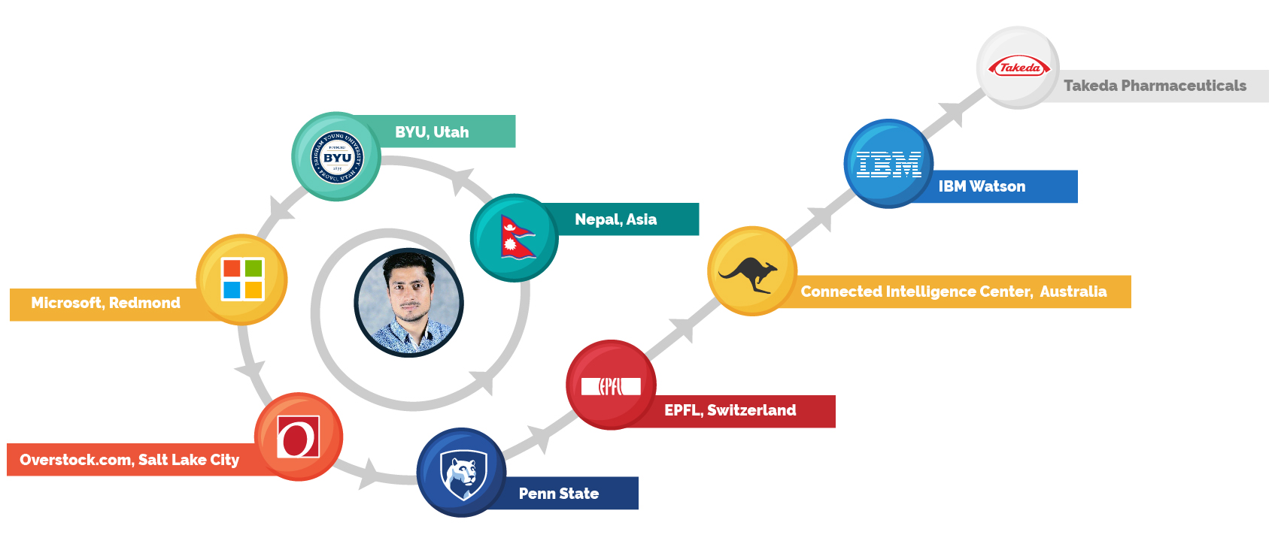
Cornell Social Impact Program
Notes:
Little bit intro about myself, My background is in PhD in Informatics, with focus on fairness and bias of machine learning systems. In particular my dissertation was focused on applying HITL to hiring decision made by the hiring software. Prior to IBM I was with Microsoft for a short time and I have participated in numerous research collaborations and actitivies with EPFL around Learning analyatics and UTS, Sydney around educational data mining.

Slide 3
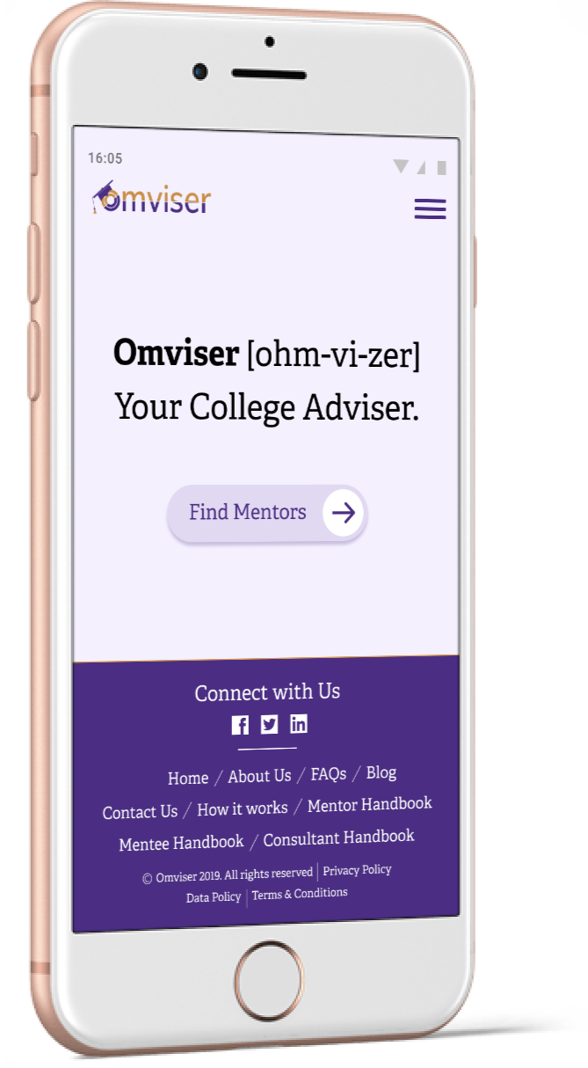


https://omviser.com/
(site under maintenance)
https://www.facebook.com/omviser
https://www.facebook.com/HCIIN
Notes:
I’m also the founder of the omviser, an educational mentorship platform. Our platform provides the opportunity for students to find a personal mentor who believe in their potential and who can help them easily maneuver through their academic decisions. Inspiration for me comes from the fact that research has suggested how individuals in economically challenged population with limited social capital utilize technologies to achieve more socio-economic security. This excited my interested to under how online platforms such as ours can be leeraged to boostrap social capital to evoke right and meanfinful connetions. Thus, one of my goals is to contextualize and uncover how and why social relationships such as mentorship, both objectively and subjectively structure the career choices and success of students, and how our platform provides conversions of different forms of cosial capital in one’s life. 0 symbolic apital (honor, prestige) cultural ,social and economic capital.
And then there’s hope that I continue to make an impact to students who needs appropriate guidance and assistance in participating in research from the global south. I founded and bootstrapped human compute rinteraction institute of Nepal for two reasons
When I read the paper by Dr Nicola Dell, and also through literature review, I gathered that most of the research data are coming from the developing countries or only a handful of select countries – because of the primary investigator’s connetions, background and ties to the home country. But then I looked at Nepal, and given no scientific research actually happens and we ond’t have as many researchers in the field. So I figured I start something on my own with collaborators, then slowly get into a phase where I start publishing work or developing technical artifacts from the other side of the globe.
(2) Secondarily. I want to pay it forward. I know what it takes to be in the country where you have limited capital power agency , I wanted to provide research experience to those students who are constrained not by the lack of talent but the lack of opportunities such as resources mentorship o rother system of inequalities.
So that’s that, I don’t want to be talking more on that. Feel free to email me or reach out via Twitter, and we can talk.

Slide 4
Fairness, Bias, Justice, Equity in AI Collaborators : Professor Lynette Yarger, Penn State Professor Payton Fay, North Carolina State University Dr. Sainyam Galhotra, PostDoc @The University of Chicago

Slide 5
Human – We are responsible
“Marginalized people are demonized, deprived. What is the point of making data driven systems ‘fairer’ if they’re going to make institutions colder and more punitive?” – (Seeta Pena ML ICLR 2020)
Notes:
One of the leaders of the ML Seeta Pena … She gave a talk at ICLR 2020 which was on a workshop called “Towards Trustworthy ML” .. One of the things that struck me from listening to her presentation was this where she says". “Marginalized people are demonized, deprived. What is the point of making data driven systems ‘fairer’ if they’re going to make institutions colder and more punitive?”
……: And this is a good sageway into an my own work…...in a way in which community responded it. In some ways, there is a drive to make systems fair for the most vulnerable groups.
=========================================
We need to learn from other disciplines who have looked at data much more rirgorously and work with them to draw lessons from ML.
We need to have an interdisciplinary approach specifically focused on data. We can learn from disciplines such as anthropology and history. I read an article by Ali Alkhatib, how we can learn from anthropology.. Architives are the human kind of collecting data, they are supposed to balanced and representatives records…. For example the state department has archives, there is internet, these things are done in systematic way. Historians are worried how these archives…
.
Technology is not value neutral - it’s political. To ay te hctechology ology is political, its not to suggest there is somekind of inherent courtersy. Rather it’s an akncolegelggement that research agenda we pursue, methodos and methodologies we adopt, and techologoes we create are value laden and it’s impossible to isolate from the social relations that structure our society.
The beleicts tha technology is value neutral…. Is too common in ML and computer science as a whole. An article be Ben Green “Data Science as a Political Action- Grounding Data Science in a Politics of Justice”… one of the key arguments that neutrality of technology , … to understand why, one must first attend to and recognize we live in a society structure interlocking systems of inequality nad oppression that digves rise to systematic and differential allocation of power, privilege and resources . critically research and deve of AI and tech, does not somehow exist outside of social relations. Instead if it deeply entageld within them. REsearchers embed values normals and assumptiuons, many of which might reflet dominant views of the society. For many, morms and values maty no bt visible (doesn’t mean it’s not there)
Our social positions in the world, and set of experiences shapes and bounds our view of the world’ this in turn affects the research questions we pursue and how we pursue them. --- Kaeser- Chen et al (2020)
Positionality-aware machine learning
Positionality is not about individual or individual choices. Positionality is not something that we can escape from , ….

Slide 6
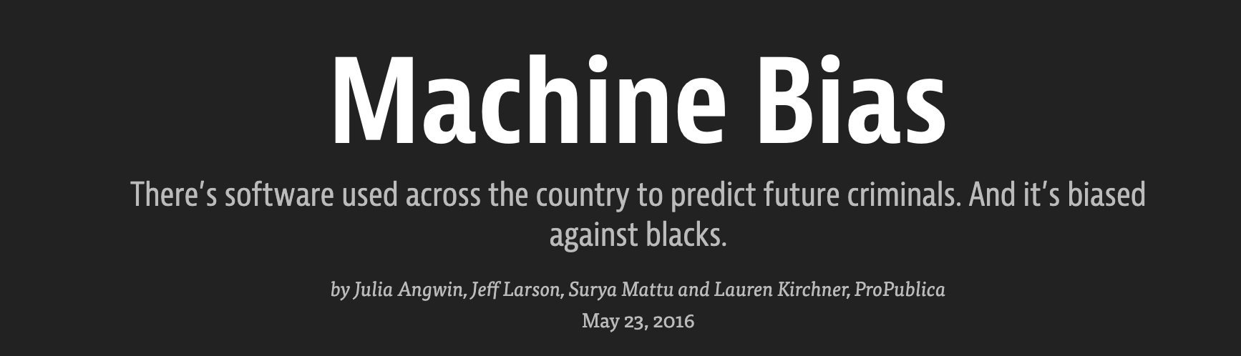

Notes:
Popular software called compass used by judges in FL,
What was observed was this software was biased against black defendants than white
If you flip the gender, the output of the software changed for 45% of the invidudalls.
There are many , in literature.

Slide 7
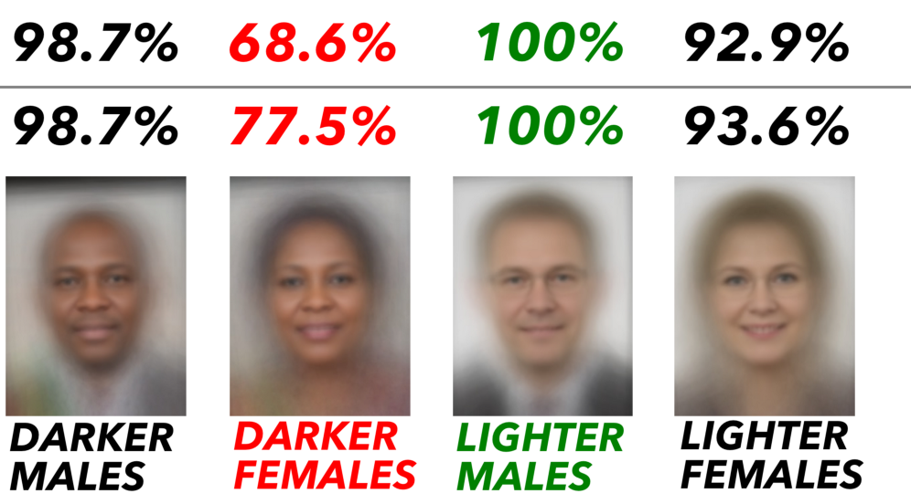
Facial Recognition
Accuracy
Notes:
A common pattern .. These algoruthms are shown to be highly accurate for male and inaccurate for females. Due to this there is a backlash for computer vision /facial recognition algoruthns.

Slide 8
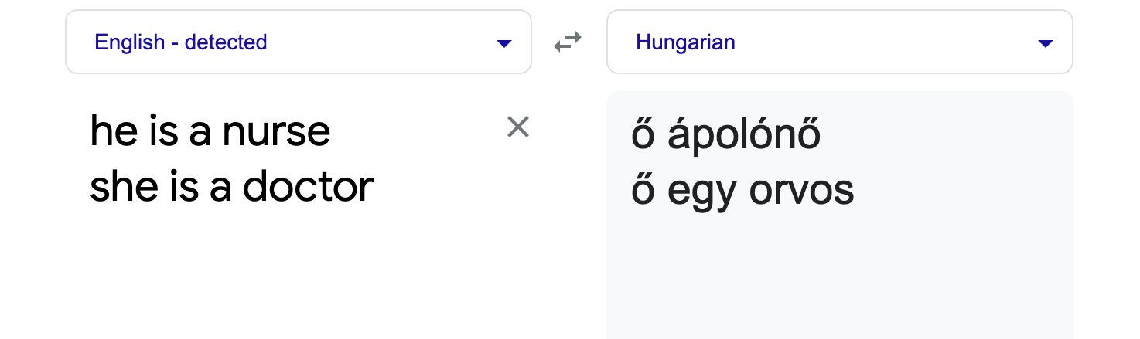
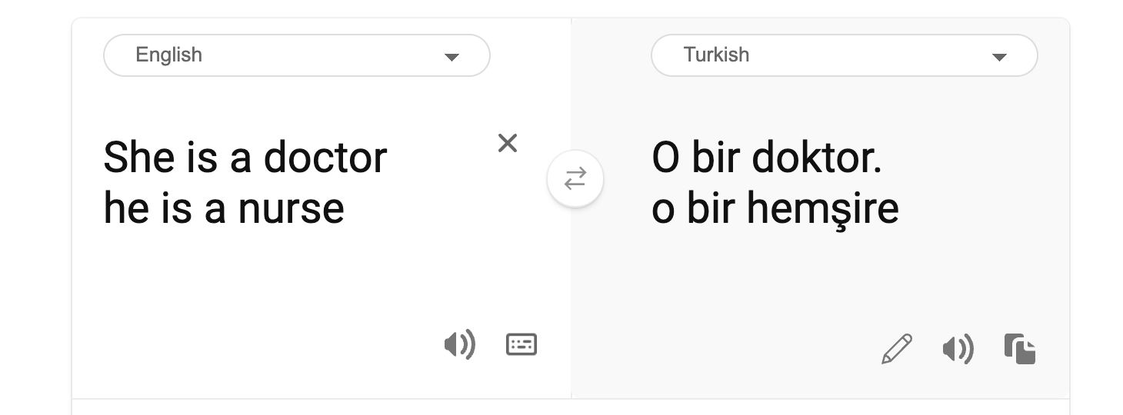
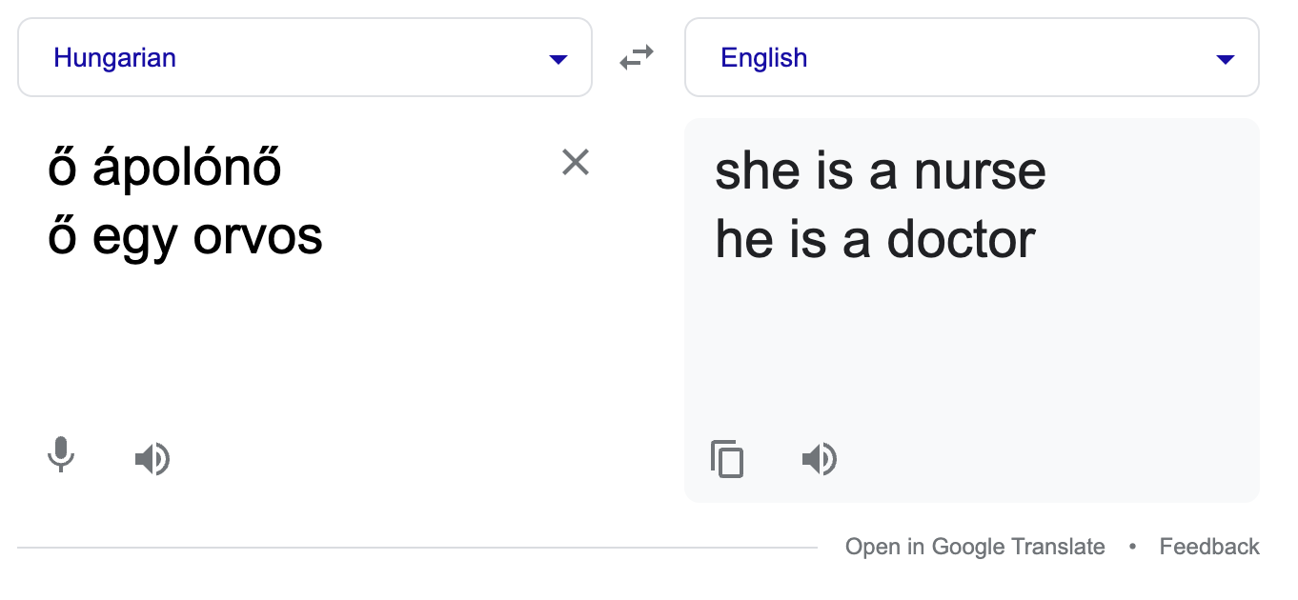
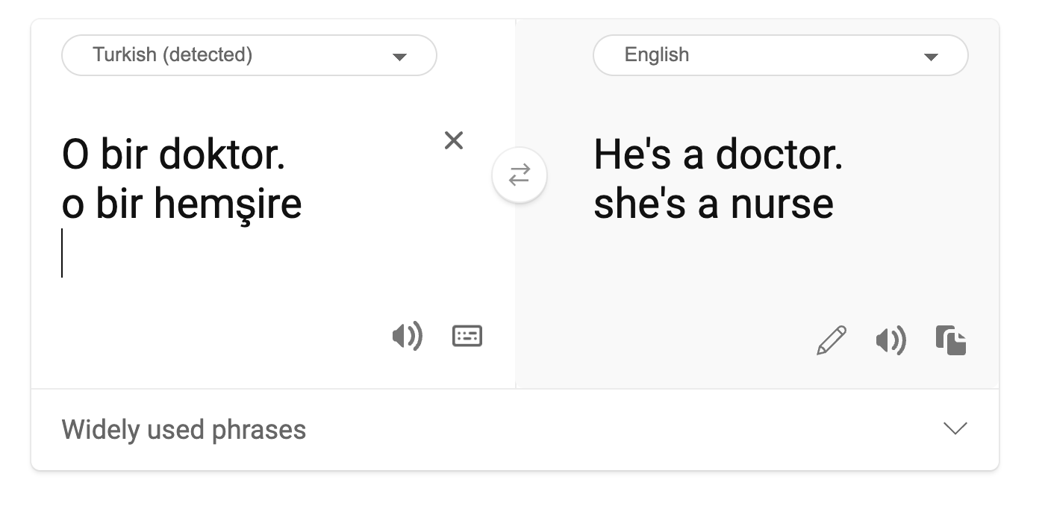


Language Translation
Notes:
Another example in lanbguyage transalation
Just so yo know tyhese two langauges (Hungarian and Turkish) is gender neutral.
The gender of nurse flipped from he to she,
And doctor flipped from she to he..
They classifiy things – because our data suggests most of that is nurse and data.

Slide 9
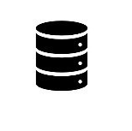
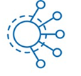
Why did these biases occur?
Prediction
output
Data
ML algorithm
Bias in
Bias out
Notes:
The common problem is the input data…. One reasons for biases in ML algortihms

Slide 10
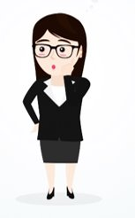


Example, Loan Prediction
Age
Sex
Race
Income
Address
Credit score
Loan
prediction
Bias in
Bias out
Notes:
Takes input atrribute4s of ibnividual whether to approve the loan or not,

Slide 11
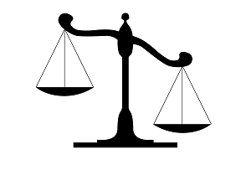
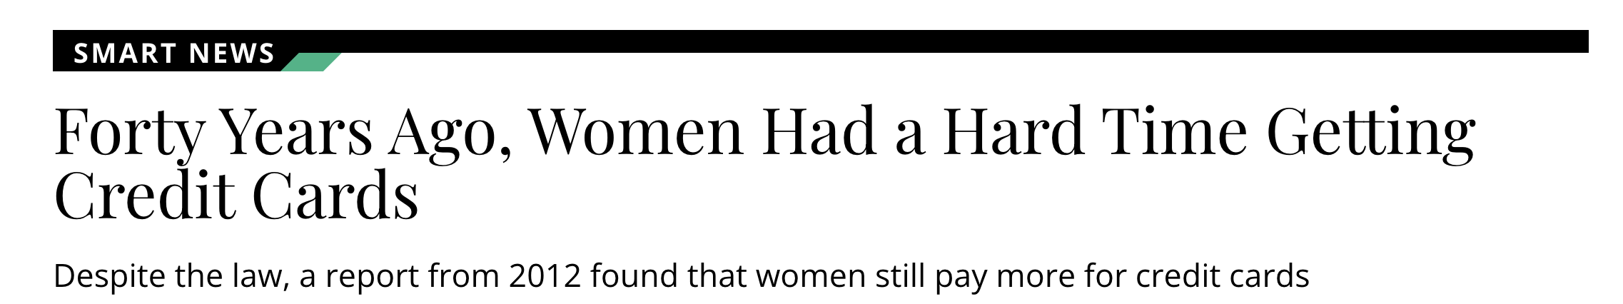
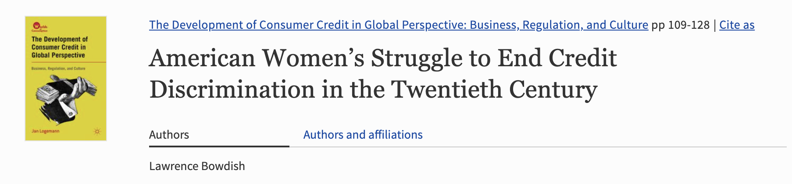
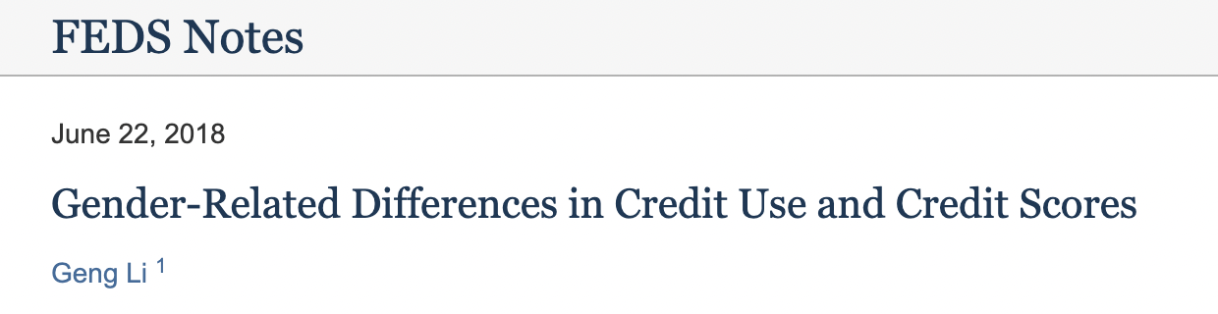
Root cause - Systemic Bias ?
Notes:
Now the most common reason nfor biases in these classifiers is the systemic bias, because classifiered were trained on the data where female were denied loans.
However, Suppose we control for systemic bias in data, and we clean such mistakes, and data doesnot have systemic bias, even in that case final preductions can be unfair.

Slide 12
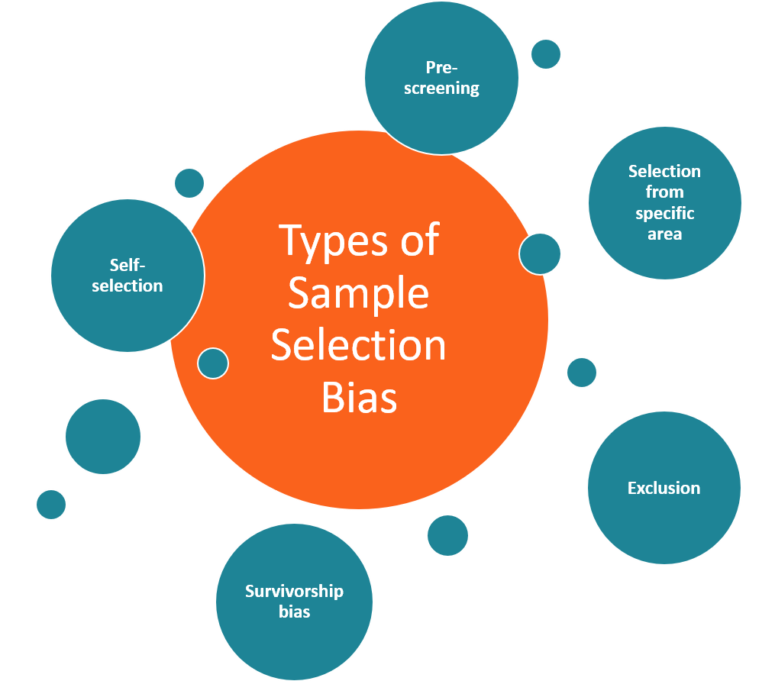
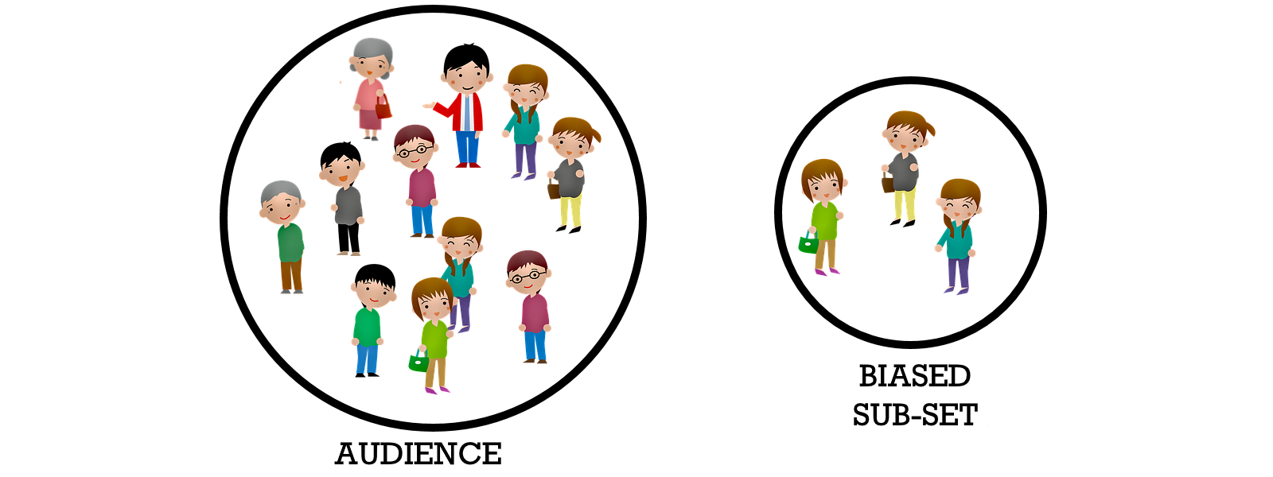
That’s because , Lack of Representation
Notes:
one of the reasons is representative bias or selection bias. When we are trainings ML clasisifers on the data set, that data set is the sample of the reaql world, and if we can’t contain that sample accurately,. It may lead to the bias.
Examplehere, on the left you see everyone , old young educated non educated
On the right it doesn’t contain any old invidiuals. This is one form of bias.
Suppose we fix these in the data, even then the classifier may still not be fair.

Slide 13
Bias is hidden
Still unfair???
Age
Sex
Race
Income
Address
Credit score
Loan
prediction
Bias in
Bias out
Notes:
Consider loan preduction software, and and we have have 6 attributes.
Zipcode to age, sex etc

Slide 14
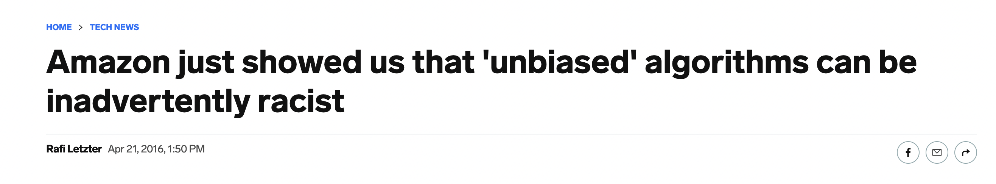
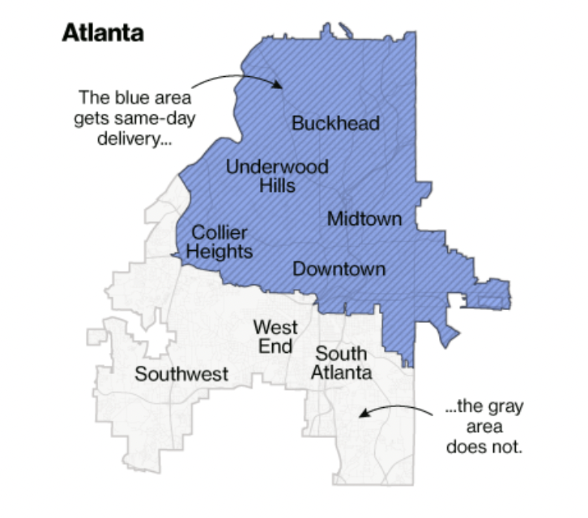
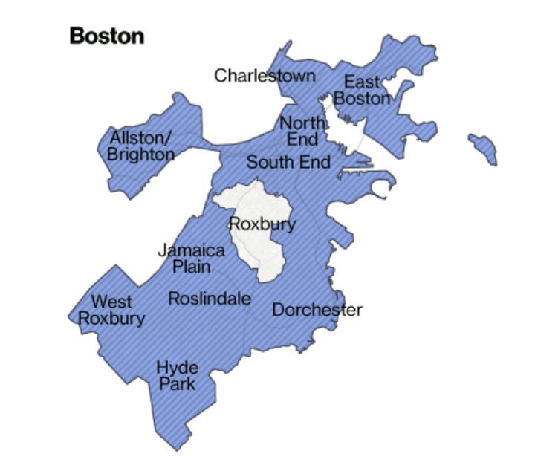
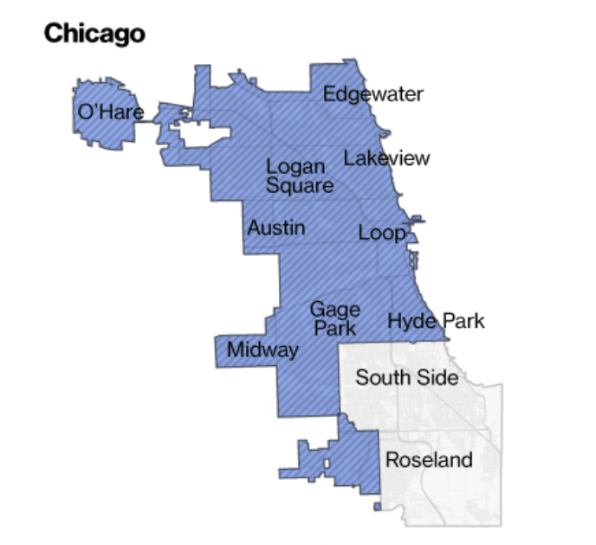
Bias is hidden
Still unfair???
Age
Sex
Race
Income
Address
Credit score
Loan
prediction
Bias in
Bias out
Notes:
When amazon release the same day or two days prime delivery, their algorithms denied some segment of the populations because of the bias in data.
Evecn though the sensitive data were hidden, we still see the issues.
In Boston, Roxbury, Soyth side were not aoffered.

Slide 15
How to deal with biases?
Specification: Correct specification of fairness requirements
Data collection: Data should be collected correctly
Data Preparation: Data preparation should not inject bias
Classifier training
System Testing
Prediction
output
Data
ML algorithm
Notes:
Here I showed you a few examples, why biases can come to the system. But how can we deal with such biases:
First and primary requirements – that fairness requirements should be specified clearly.

Slide 16
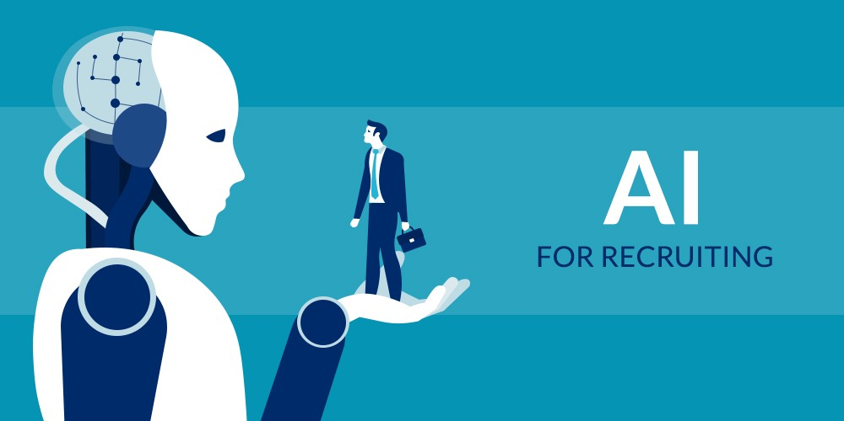
AI in hiring
Source: https://becominghuman.ai/ai-for-recruiting-everything-you-need-to-know-ba30ba860a6c
Notes:
Right now, if you look at the literature, white reports and industry results, really kind of split between opportunity in AI used in hiring systems , being excited about it and the fear of unknowns. The good news is that AI has the potential to first help people retain or acquire new skills much easily than in before, and there is so much of potential but… Widespread use of AI and automation in recruitment have drastically reduced the need for human involvement but with the proliferation of AI, ML and DS even the organizations are concerned about the recruiting practices surrounding these systems.

Slide 17
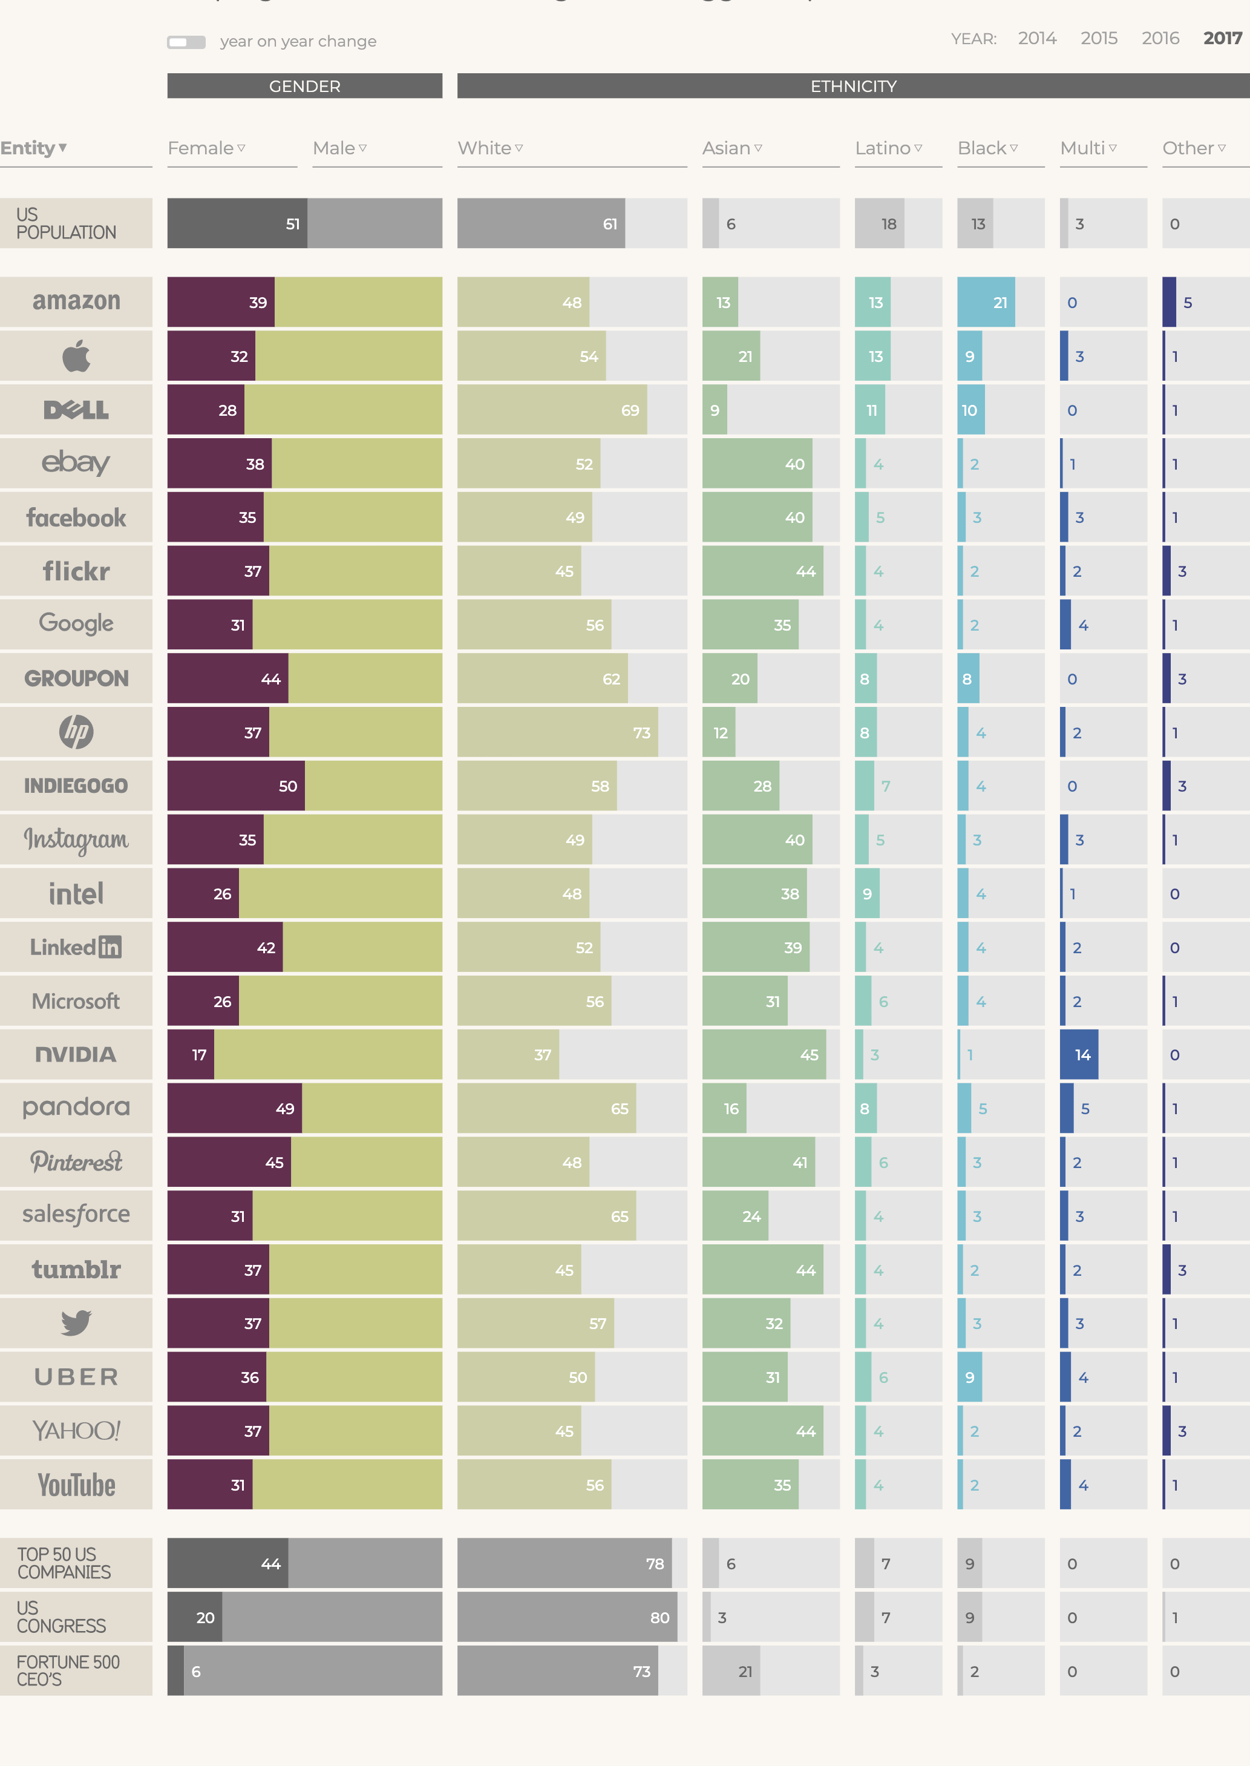
Under representation in IT workforce
Source: https://informationisbeautiful.net/visualizations/diversity-in-tech/
Notes:
I stand here as a first generation, immigrant with limited social capital and adequate amount of technical experience. My background is fairly represented among technology companies. But believe it or not, at one pint I was wrongly perceived and judged by my accent during a job interview, and I know what it’s like to be misunderstood.
With that acknowledgement, and in the spirit of this talk I’d like to start today by inviting you and asking of myself how I would have situated myself as a college graduate from an underrepresented community, applying for a full time programming job to a technology company.
And then there’s a bigger picture of the problem - as we already know that women, african america, latinx don’t have a significant presence in the tech industry today. They only represent less than 20% of tech workers and this needs to change. As you can see from the data in 2017, Only about 39% of amazon technology workers are female and just about 21% are black. And this needs to change.
We already know where we are, We know the corporate world needs to change, and yet nothing is changing.

Slide 18
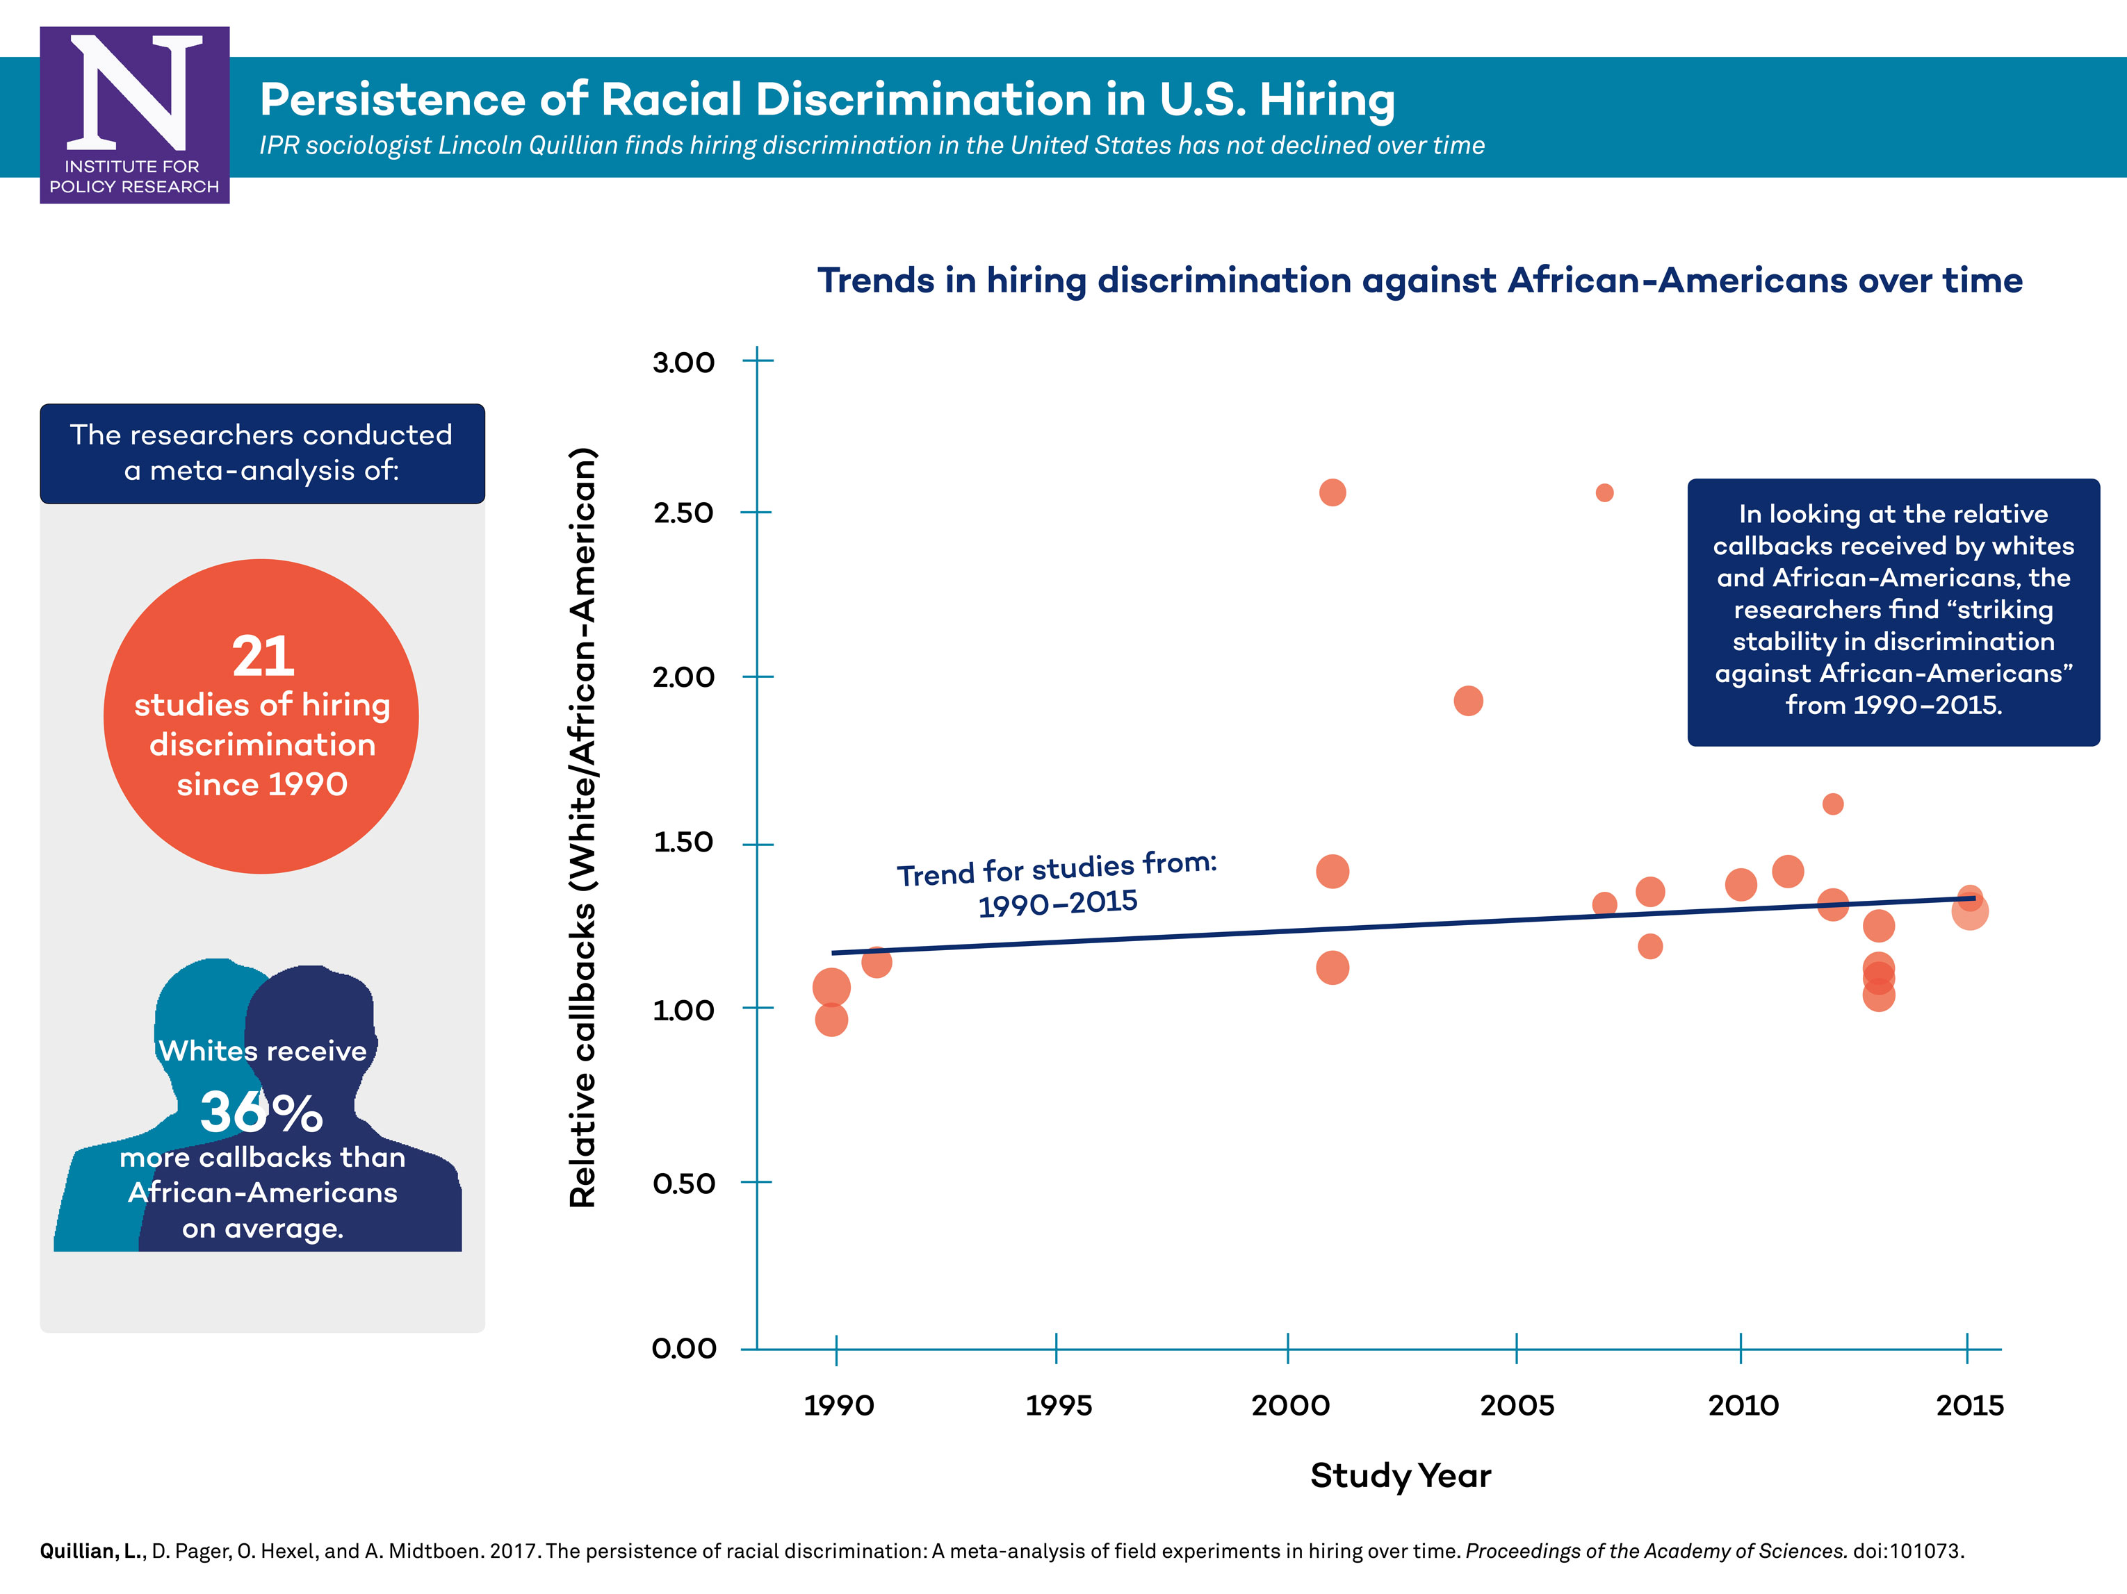
Discriminatory Hiring Practices
Source: https://news.northwestern.edu/stories/2017/september/research-finds-entrenched-hiring-bias-against-african-americans/
Notes:
Similarly, In a Northwestern meta-analysis, researchers looked at trends in hiring discrimination in America against African-Americans and Latinos and they found no change in rates of discrimination in their field experiments of hiring from 1990 to 2015. We often hear that prejudice and discrimination are fading out over time But the research found striking stability in discrimination against African- Americans.
and these results support the need for further research in these areas.

Slide 19
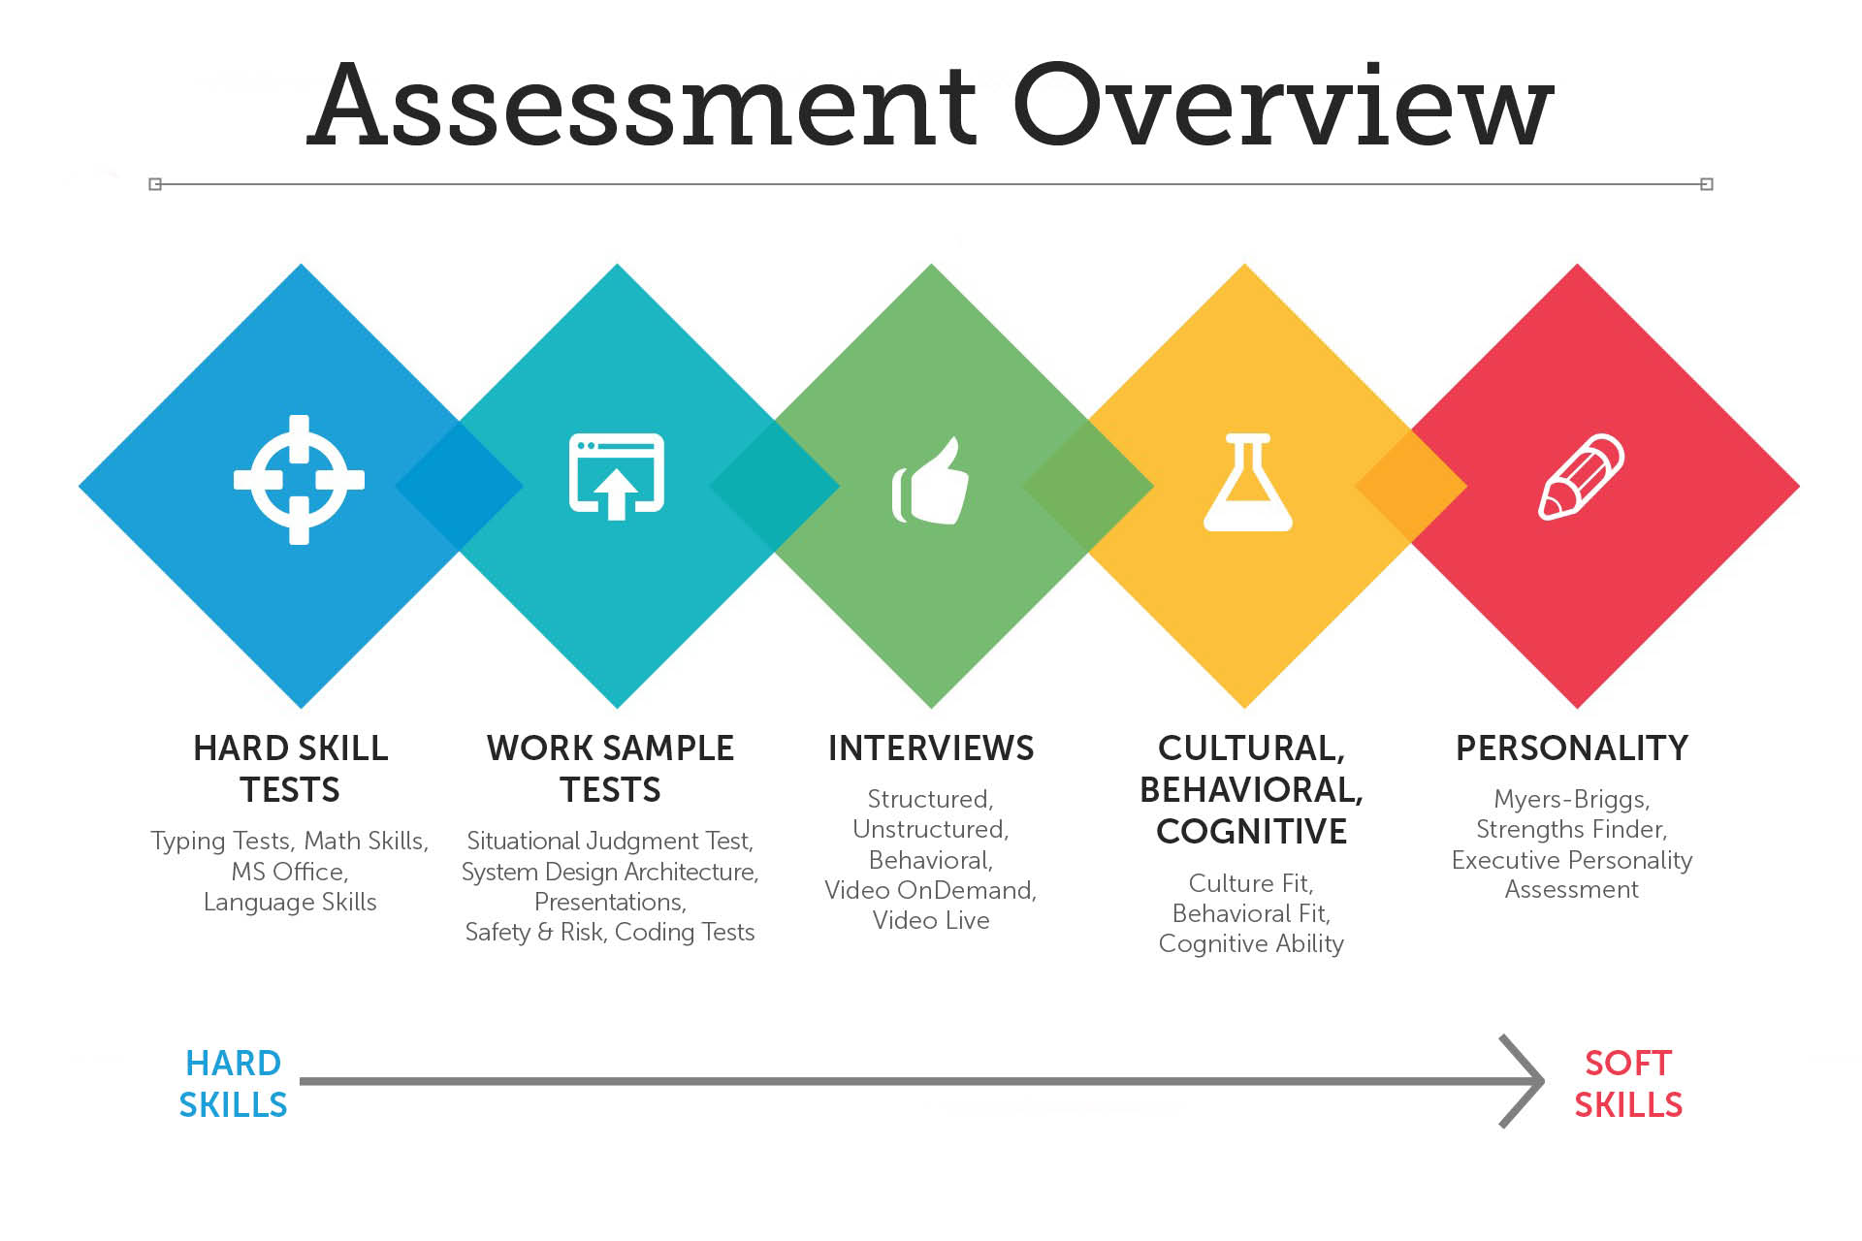
Hiring Stages
Talent Search
Screening & Shortlisting
Interviewing
Evaluation & Offer
Image Source: https://www.hirevue.com/blog/hiring/assessment_overview
Notes:
Typically these systems are being deployed anywhere from sourcing the job candidates, to screening and short listing them, interviewing and recording, scoring and ranking of the candidates, and evaluating them. During this end-to-end processes, candidates are often evaluated on hard skill, soft skill, their work sample including their personality and cultural, behavioral and cognitive functions.
For the purpose of the research, we focused on the part that occur right after a job seeker applies for a job and get a call/request for some forms of interview until the point they hear the outcome of the interview. That is to say, we focus specially on ‘interviewing experience’, and not so much as applying for the job and getting selected for the interview.

Slide 20
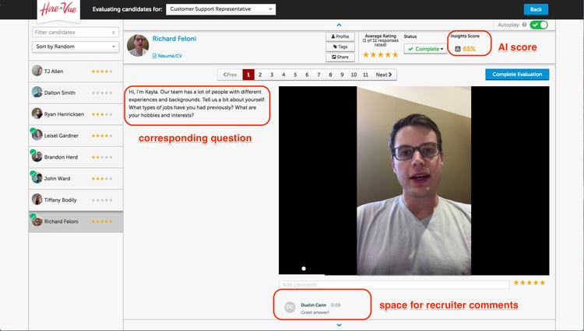
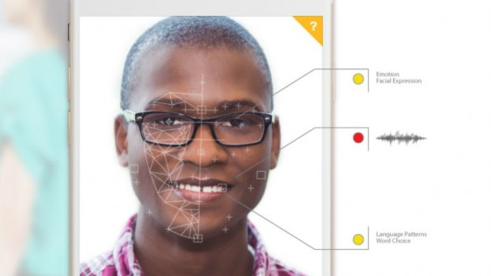
HireVue
Image Source: https://www.businessinsider.com/hirevue-ai-powered-job-interview-platform-2017-8
https://strategyonline.ca/2017/07/11/unilever-sees-big-hiring-changes-thanks-to-online-games/
Notes:
Then there is hirevue… a highly successfully startup. Their software tool is used by many companies , they used to be used by Nike, education companies, IBM at some point in the past, UAE government etc. What they do is, instead of shifting through thousands and thousands of resumes by human, they doit by automated way, they have an algorithm that does it for them. Basically, when you are interviewing for a job, they send you a link, you then open and start recording yourself. Let's say in the tool that there are four questions you needed to answer, and some of the responses require you to record video. Candidate are not directly talking to a HR rep or a hiring manager, just a, pre recorded interview questions and the camera.
The tool detects emotion, it also checks your verbal and non-verbal causes. … According to hirevue, responses to these video interviews contain full data, as such the content of the verbal response, intonation, and non verbal communication are just a few of the 25000 data points that they analyze…. In short, they are using artificial intelligence to quantify human behaviors, human expressions, human voices turning them into data….
Now, Let’s ask a few questions here - one is ; let’s say everybody uses this tool for everything, so your point of entry to applying for any job is actually like this everywhere. Let’s say the tool has a particular kind of glitch that it always finds you angry and grumpy no matter what, and that means you might not get a job in any part of the world ever, for anything.,right?
Second, let’s think about determining internal state? What do you mean by determining internal state? Does ML really does that well? It’s one thing to determine if a person is smiling or not, but when people are talking about - am I happy or not happy? You know it’s wrong. We should really think through the implication of some of these , as in who they are supporting or harming, and who they are funded by, right? It’s not people from marginalized advocating these kinds of tools, also we don’t know what the characteristics of hirevuew is like, it might have a single point of failure or it might no, it might not have a glitch or it might, it may be violating things like equal employment opportunity laws or it might not, I don’t now. But right now we don’t have ways to investigate these tools before it gets unleashed to the world outside (just like FDA tests drugs for side effects, before these get entered into the market); similar things are not happening here.

Slide 21
Study 1: Algorithmic equity in the hiring of underrepresented IT job candidates
Evaluate the perceptions of student job seekers on the justice and fairness of AI talent acquisition use and outcomes, and
Develop design recommendations for identifying and mitigating bias in AI hiring systems
Notes:
This brings to the purpose of our study here - We did this research study for two reasons - one is that there are still very few socio-technical and design oriented literature that incorporate issues of video based AI hiring systems among job seekers, and virtually none that considers experiences of marginalized college graduates adopting these tools. And we take the design centric view of some of these tools in itself.
Specifically, the first research question explores job seekers' perceptions of the AI based hiring tools and addresses these questions around how individuals react as they discover their job applications were evaluated by autonomous systems.
The second research question addresses questions around whether job seekers think they were exposed to equitable hiring practices and fair outcomes.

Slide 22

Research Questions
RQ1: What are the perceptions, attitudes, and experiences of job seekers’ towards procedural justice in AI-based hiring processes?
RQ2: How do job seekers interpret the results from the AI-based hiring systems with their existing or newly formed impressions about equity in the IT workforce?
Notes:
So our research questions belong to this:
RQ1: What are the perceptions, attitudes, and experiences of job seekers’ towards procedural justice in AI-based hiring processes?
RQ2: How do job seekers interpret the results from the AI-based hiring systems with their existing or newly formed impressions about equity in the IT workforce?
Specifically, the first research question explores job seekers' perceptions of the AI based hiring tools and addresses these questions around how individuals react as they discover their job applications were evaluated by autonomous systems.
The second research question addresses questions around whether job seekers think they were exposed to equitable hiring practices and fair outcomes.
=======================================
{I don’t see them as overlapping, and they are related questions obviously. They seem to be, uhh,. they are very close, and they are related to another. But They are not the same thing and they don;t seem to be answering, you couldn’t seem to answer them the same question… Just to be clear on this - the way I am doing this is the first one is asking about the process and the second one is asking about the outcomes. Does that make sense?
Procedural justice is about how, is everybody getting the same, going through the same processes weighted against people in one way or another, and the second question asks do people have the same odds , are people represented in the fields? }
--- Well, we didn’t reject it because it didn’t occur to us. We didn’t think about toys, that's a good idea for our future work. We went in this direction because of the function of the data we had….
Also it is a function of the data we had, and the students were also bringing something, their data would drive us to different ideas that people have…
Have you thoughts about hiring a manager? We thought about it, we couldnt get hiring managers to sign on and they had all these concerns, and we couldn’t do it….

Slide 23
Equity and Justice
John Rawls’ concept of "justice as fairness", shifting the philosophy of distribution to the greater society (societal equity) instead of individuals (Rawls, 1999).
Equity as a form of distributive justice
Equity approach as a response to address the issues of deprivation and a way to address those left out from among the most disadvantaged groups ( (Rawls, 1999; Sen, 2009).
Notes:
When people talk about justice, people are mostly talking about stuff – like who has more stuff. Whether that’s money, healthcare, jobs or access. Who gets to decide who gets what and on what basis? The area of moral philosophy that considers these questions is known as distributive justice, and there are many different schools of thought out there. So, we used Equity as a form of distributive justice to answer one of our research questions.
While the equity paradigm here suggests investing in the transmission of services to people who need them most, and it aims to address this through targeted action for the most disadvantaged groups.
What we focus on here, is also a very simple sounding approach advanced by twentieth century American Political philosopher John Rawls, he argued justice is fairness. And inequalities that exist in the social system, Rawsl said, should favor the least well-off, because this levels the playing field of the society. This is a form of need-based justice that focuses specifically on making sure that everyone is actually in a position to achieve their basic needs. So, Rawl’s sense of justice means correcting for those disadvantaged that are beyond our control (even in natural phenomena).

Slide 24
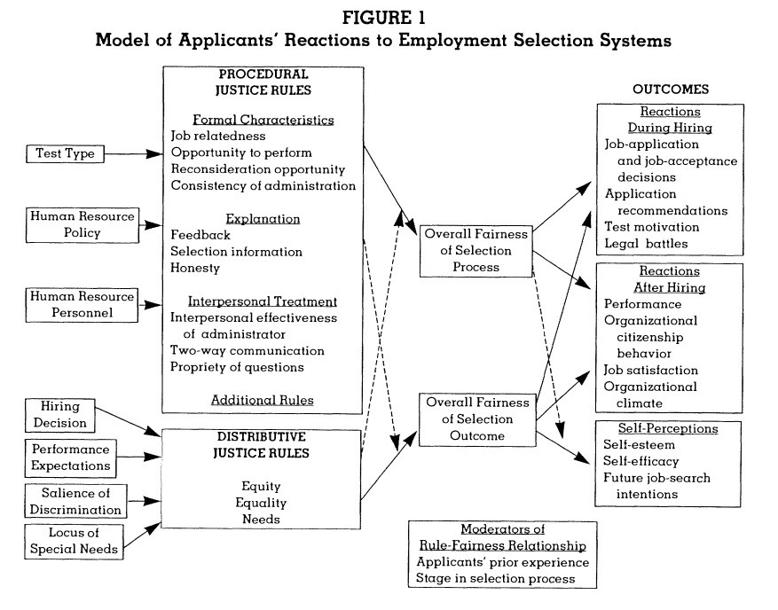
Equity and Justice relationship
Notes:
So we looked at things like whether the tool provided candidates an opportunity to express themselves freely, whether there was a justification for the decision made, whether the applicants have opportunities to offer input as a part of the process, and things like that as a part of our investigation.
=======================================
EQUITY AND JUSTICE
The basic problems of the equity theory is that it employs a unidimensional concept of fairness and that it emphasizes only tka fairness of distribution, ignoring the fairness of procedure. In contrast, the alternative to this theory is procedural justice.
So for my thesis, the final judgment evolved from a combination of these two. I didn’t think a single approach would have answered both of my research questions. The problem with the equity is that it only considers the final distribution of reward (outcome), and focus is on fair distribution. But it ignores how you reached to the outcome.
And in our case, I found out a few studies that studied the impact of procedural factors on perceived fairness. And little is know about an individual’s evaluation of preoceural compoonents of these system taht regulat the alloative process. The procedural concept here focuses on the individual's cognitive map of events that precede the outcome or a distribution of reward, and the evaluation of those events. I felt like perhaps the best way to introduce the concept of procedural fairness is to relate an incident that occurred which is also why qualtiaitve methodology was used.
I am aware that tnormnally equity and procedural justice go totherghier but I also don’t thjin a single approach would have solved my research questions. However, because equity and justive is so prominent int he contect of our study, and the sample, it is the focus of our thesis..
========================================
Then there is Justice. The reason people talk about justice all the time is that it’s one of the most fundamental, social, ethical and moral principles we deal with every day. Justice has different definitions.
Is justice about equality and fairness? Getting what we deserve? Getting what we need? Sometimes we talk about balancing the scales of Justice. Sometimes It goes back to the ancient Greek understanding of Justice as Harmony – In this view, a just society is one in which everyone fulfills their roles so that society runs smoothly . In that case, violating your place in the social order even if it's a place you don’t want to hold – is considered unjust. Other times, justice has been understood in a more utilitarian way - where being just is one that tries to increase the overall quality of life of its citizens. And for a political libertarian, a just society is simply one that allows its citizens to be maximally free. So what is it?
Some people believe that everyone should get the same kind and amount of stuff, no matter what. This concept is known as Justice as Equality. It sounds totally fair, but Is everyone getting the same stuff really, Justice? Because I need or want- different kinds of and amounts of stuff than you do. So there is also the idea of need-based justice. This says everyone shouldn’t get the same because our needs aren’t the same , and by this logic justice is getting based on what we need. Those who need more, get more. And some of these make sense. While others argue that it amounts to favoring some people over others, putting those who happen to not be in need, at a disadvantage. And if that’s how you look at things, then you probably espouse some kind of merit-based justice, which says that Justice actually means giving unequally, based on what each person deserves. And either you deserve stuff and you don’t, based on what you’ve done. This view rewards hard working.
If you look at philosopher Robert Nozick disagreed with Rawl’s idea that justice-is-fairness . And to demonstrate that through his basketball experiment he said, “we’re each entitled to the stuff we have ,provided we didn’t steal it / otherwise obtain it unjustly. As you can see, there is a lot of disagreement about what it means to be distribute justly.
==========================================
{Why Procedural Justice}
A little bit more nuanced way of looking at this is people have sense of what fair outcome is, and they are still interested in the outcome which is equity approach. But past research has indicated that people are also interested in the process no matter what the outcome is, the process through which outcome is achieved.
In connection with acceptance model, procedural justice is more important because the organization has no influence on factors of distributive justice such as test results or the size of the applicant pool. On the other hand, the company can promote procedural justice through fair procedures, feedback and explanation of the processes. Procedural justice includes assessments of the flow of personnel selection procedures. Distributive justice or distributive justice relates to the selection results.
We looked at applicant model which is this. We also looked at Heuristic model by Ryan and Ployhart (2000) which talks about the relationship between the characteristics and perceptions as well as between perceptions and results is moderated by aspects such as expectations, desirability of attitude, alternatives, norms and selection ratio. Then Hausknecht et al. (2004) integrate the model of Gilliland (1993) and that of Ryan and Ployhart (2000) which is moderated by further variables (e.g. job attractiveness, alternatives). And because some of the work from Hausknect was a little too elaborate than we require, and the work by Ryan relies more on quantitative data and higher sample set, I believe Gilland’s applicant acceptance model is a good one to conduct the study of our mature.

Slide 25
Interview questions mapping
How much does the task that the system asks you to perform during the interview relate to the actual job? (Job relatedness)
How much does the system allow you to demonstrate job skills during the hiring process? (Opportunity to perform)
How much does the system allow you to challenge their hiring decision? (Reconsideration opportunity)
How well does the system ensure that hiring procedures are consistent across people and over time? (Consistency)
How timely and informative is the feedback provided by the system making the hiring decision? (Feedback)
How much does the system provide information to justify your decision making? (Selection Information)
How much does the system exhibit truthfulness when communicating with you? (Honesty)
To what degree does the system treat you with warmth and respect? (Interpersonal effect)
How much does the system offer the opportunity for you to offer input or to have your views considered in the selection process? (Two-way communication)
How much does the system use invasive and improper questioning, or prejudicial statements during recruitment? (Propriety of questions)
How much does the system make a fair hiring decision? (Decision fairness)
How much do you trust that the system makes good-quality hiring decisions? (Trust)
Notes:
After the workshops were completed, we conducted interviews approximately one hour in length with 11 participants who had some kind of prior experience with these tools. Interviews were semi-structured, with questions focused on gaining further understanding of the participant’s perceived fairness, concerns, opinions, and their feelings in general.
The questions shown on the slide are not the ones that were asked to candidates, and the conversation was contextualized given the semi-structured nature of the study. But I took those questions and map them to the procedural justice rules as suggested by Gilliland’s theory.
===============================================
Questions like:
What positive and negative experiences have you had with video recruiting software? (feeling/perceptions)
Describe what you know about how your platform reviews your applications for specific roles, and how you think it makes recommendations to hiring managers.
What happens after you click the submit? Do you know what’s going to happen to your data?
How would you expect these tools to influence your employability? (Understanding of the software)
In general, what challenges have you faced thus far in applying and interviewing for the jobs using these tools?
========================================
Some data extracts might fit into multiple themes. Here, some of the extracts could also fit into a search theme.
You keep doing this until you feel that you have a set of themes that are coherent and distinctive; then you go through the same process again in relation to your entire data set. You read through all your data again and consider if your themes adequately represent the interesting themes in your interview and if there is uncoded data that should be coded because it fits into your theme.
the main point is to gain good understanding from different perspectives of an investigated phenomenon. That should not necessarily mean cross-checking data from at least two sources or methods and confirming it is correct or not. It's more to increase the level of knowledge about something and to strengthen the researcher's standpoint from various aspects.
also identified and described a host of contextual and system factors with specific suggestions

Slide 26
Findings
Data of the Past amplifies historical inequity
Shared Identity
Impression-Management
Human Interaction and Decision Making
AI as black box device
Suppression of the two-way conversations
AI as a corporate shortcut
Notes:
Next, centering around our research questions we did some coding of the data to identify the themes and subsequently these findings here which are: The key assumption among participants was driven by the concepts of identity-matching and vague concept of ‘cultural and organizational fit’. They said something along the line of. “There is a bias that everyone holds. Preferring for someone who looks like you, people tend to like people who they share identities with them” .
Participants also mentioned how thinking alike and talking about the common characteristics, such as institutions they attended, their background, color of the skin match during the in-person interview led them to a job in the past. But now they identified that these tools provided a way for them to circumvent topics of shared identity compared to face to face interviews., and they felt like power is on them when it comes to elements of shared identity or elitism.
But some of them also expressed desires to understand what parts of identity are extracted by and in these systems, with or without permission, and how that is being inhibited or promoted within the results of the interviews itself.
The term ‘impression management’ was often used synonymously with ’self-presentation’.
They think along the line of ``I can present myself in a way that I want, I can put forth my best self; perhaps demonstrating how they are “whitening” their impressions.
Some participants also expressed confusions on how they should go a bout creating an impression over online systems vs face to face interviews.
I think my take-home message here is fairness is not just about data sets, and it’s not just about math. Fairness is about society as well, and as engineers, as scientists, we can’t really shy away from that fact that ‘just how pervasively our technology is being used to marginalize many groups of people.’ There has been so much work in machine learning and computer vision, even if you look at public datasets as LFW, IJB-A, Adience, and we found that these datasets are overwhelmingly lighter skin, overwhelming male, so we need to balance out these datasets by gender, race et cetera. And it’s not just datasets or hiring as one snapshot event, it’s really important to think about beyond the diversity of datasets, we have to have structural representation and real representation and accounting for the inequities and oppression that have existed throughout history.
In the hiring systems using hiring algorithms, if under-represented groups of people are likely to be weeded out from the hiring pool due to existing systemic practices, historical disparities and inequities will be captured and reflected in the decisions made by these software tools. If the existing practices are embedded in the data that is fed into these algorithms, the software will make similar kinds of discriminatory judgments that our society has been making for the ages

Slide 27
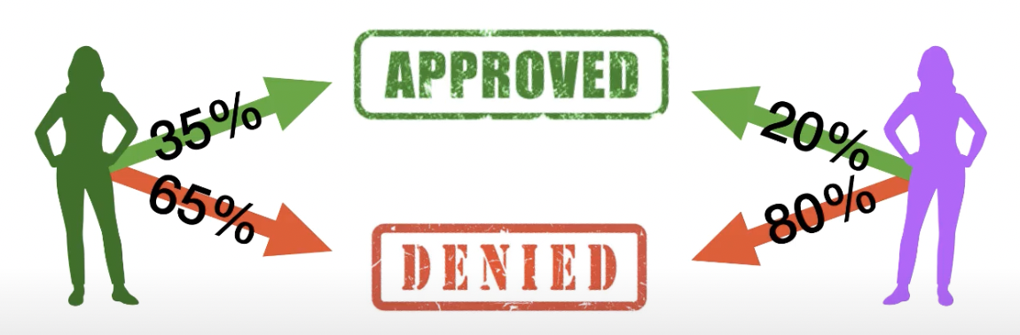
Requirements: Demographic Parity
Does not capture individual level unfairness

Slide 28
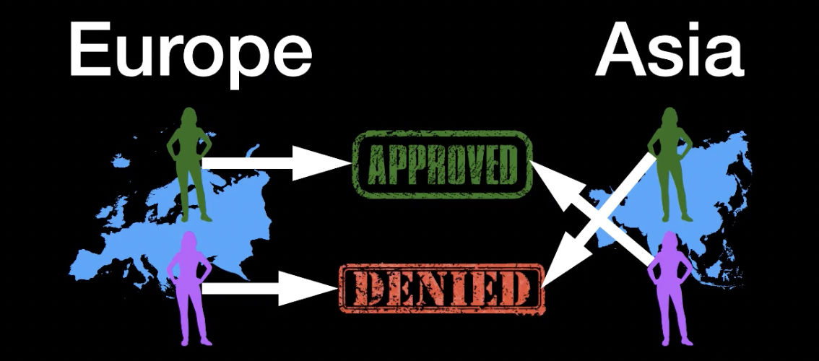
How can it fail?
Approve all green and deny all purple
Approve all purple and deny all green
European and Asian biases cancel each other

Slide 29
How can it fail?
Equalized Odds
Treatment Equality
Representation Parity
Accuracy Equality
Approve all green and deny all purple
Approve all purple and deny all green
European and Asian biases cancel each other

Slide 30
How can it fail?
Equalized Odds
Treatment Equality
Representation Parity
Correlation does not mean causation
Correlation (Color, Loan Approval) = 0.75
Accuracy Equality
Approve all green and deny all purple
Approve all purple and deny all green
European and Asian biases cancel each other

Slide 31
Causal Testing
Hypothesis testing:
?
Sensitive attribute should not affect the output

Slide 32
Study 2 : Tell Me More: The Effects of Mobile Screen Size on Self-Disclosure.

Slide 33
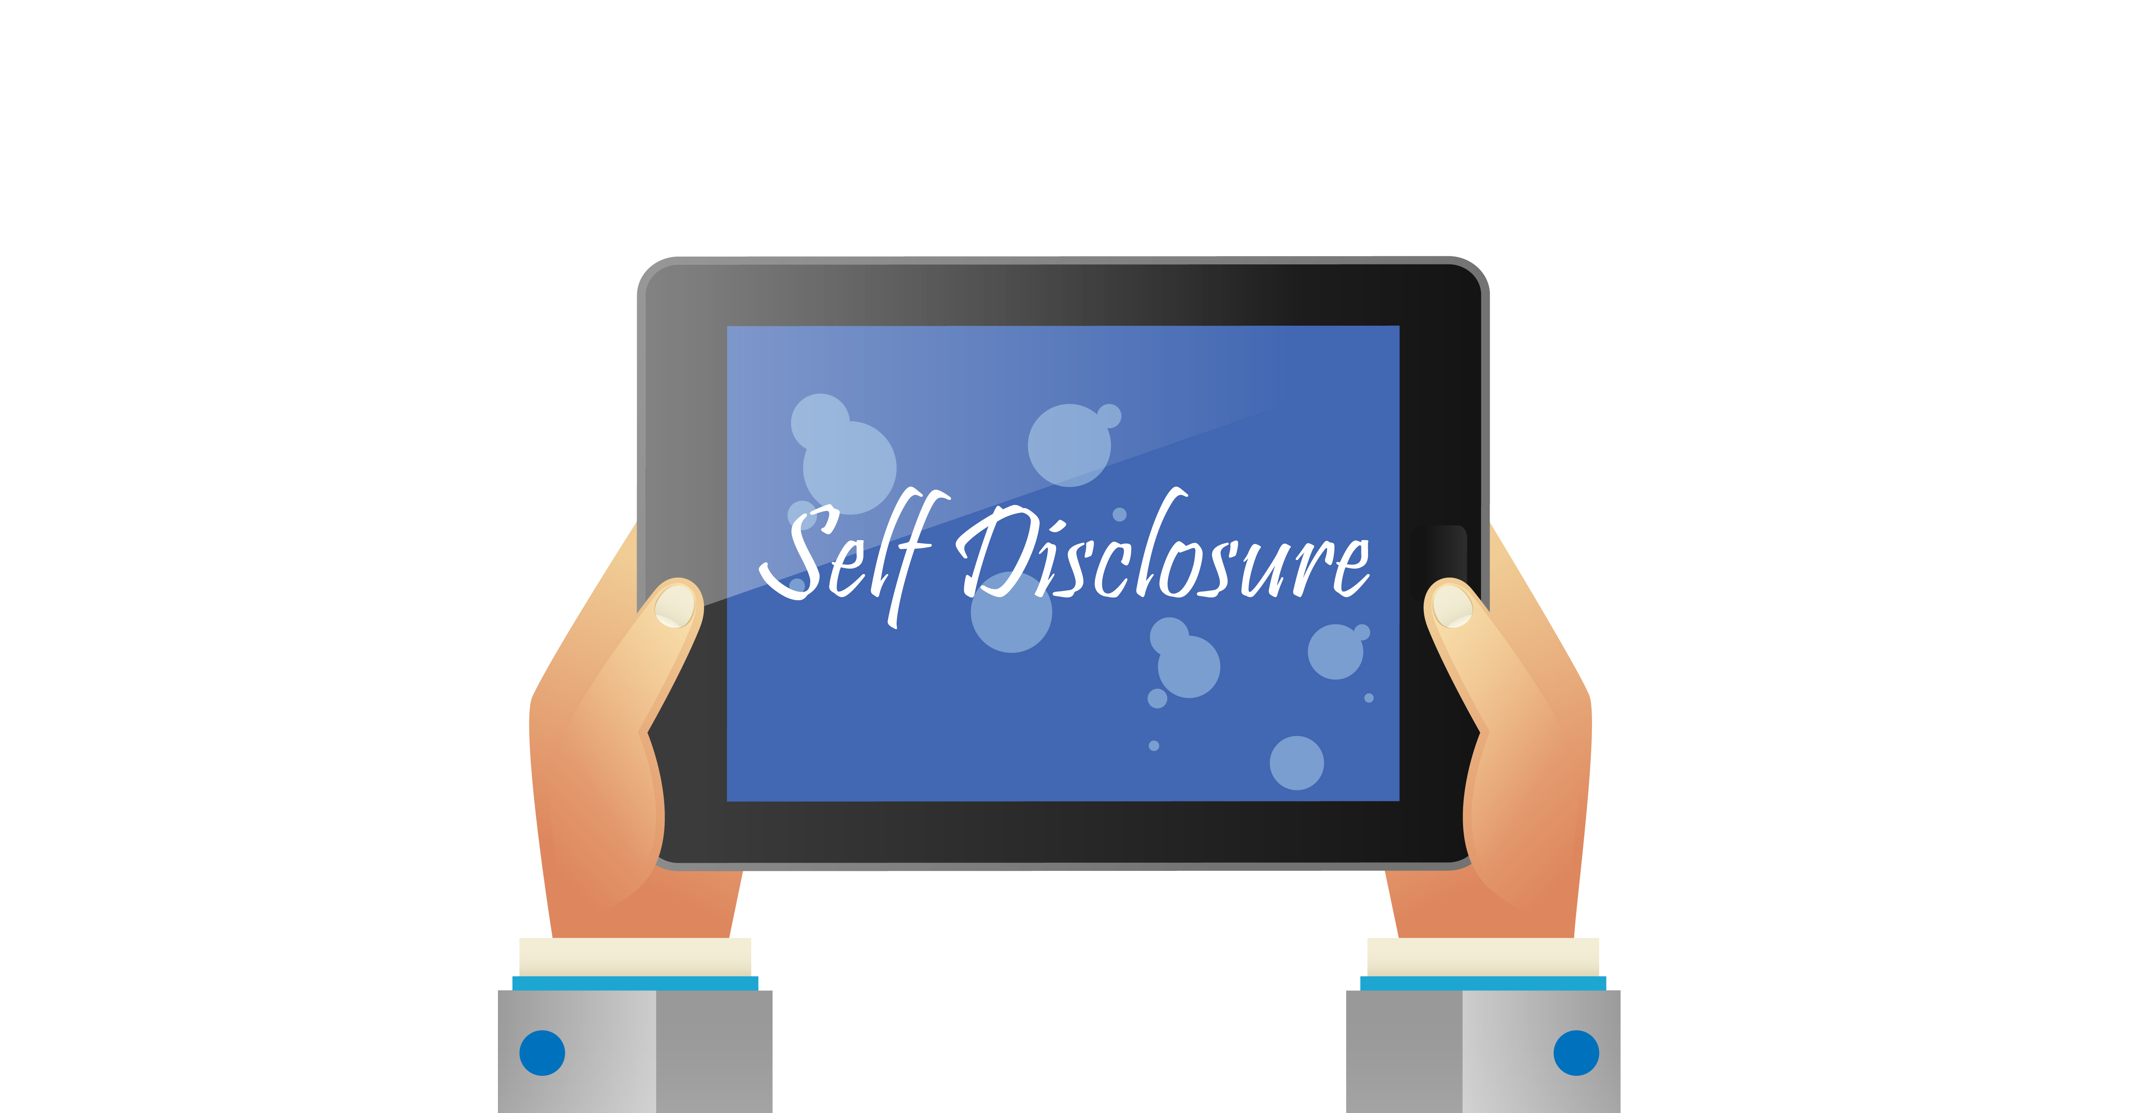
Psychological Effects of Mobile Devices
(Phones/Tablets)

Slide 34
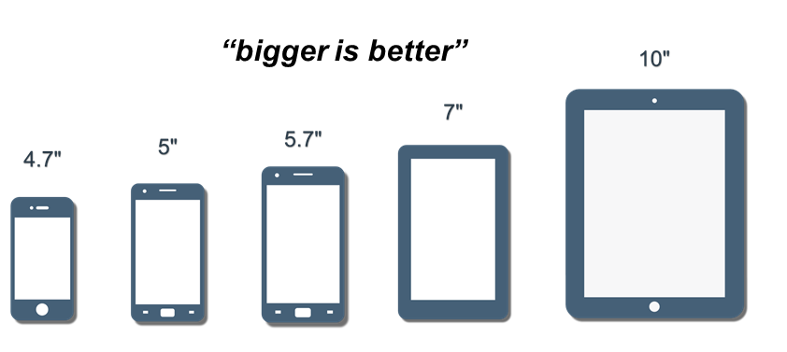
Psychological Effects of Mobile Screen Sizes
Larger screen → Higher efficiency (Raptis, Tselios, Kjeldskov, and Skov, 2013)
Larger screen → Increased trust in contents (Kim & Sundar, 2016)

Slide 35

Social Interface and Online Self-disclosure
Social Exchange Theory (Emerson, 1976)
Technology Acceptance Model (Davis, 1989)
Social Interface Theory (Norman L, 1989)

Slide 36
Research Study
What is the relationship between physical attributes of mobile devices such as screen sizes and users’ information disclosure behaviors?
(a)sensitive health information
(b)sensitive transactional information

Slide 37
Hypothesis
H1/2/3: The relationship between the screen size and disclosure will be mediated by following factors:
Perceived intimacy
-
+
Screen size
+
Perceived trustworthiness
Self-disclosure
+
+
-
Feeling of being watched

Slide 38



Conclusions
Screen size matters
Context matters
Power usage matters

Slide 39

Research has shown that use of smartphones to access social networking sites actually decreased the likelihood of private information disclosure than using pc (Kisekka, Bagchi-Sen, & Rao, 2013)
Interface Design with the screen in mind Enrich viewing experience
Making an impression
Globalization Improved features Design for culture,
context, and styles
Marketing Effective advertising Target your budget on what really motivates users to take action
Growth Campaigning with cross-screen appeal Not only to the right senses but also the right screens

Slide 40
Others….

Slide 41
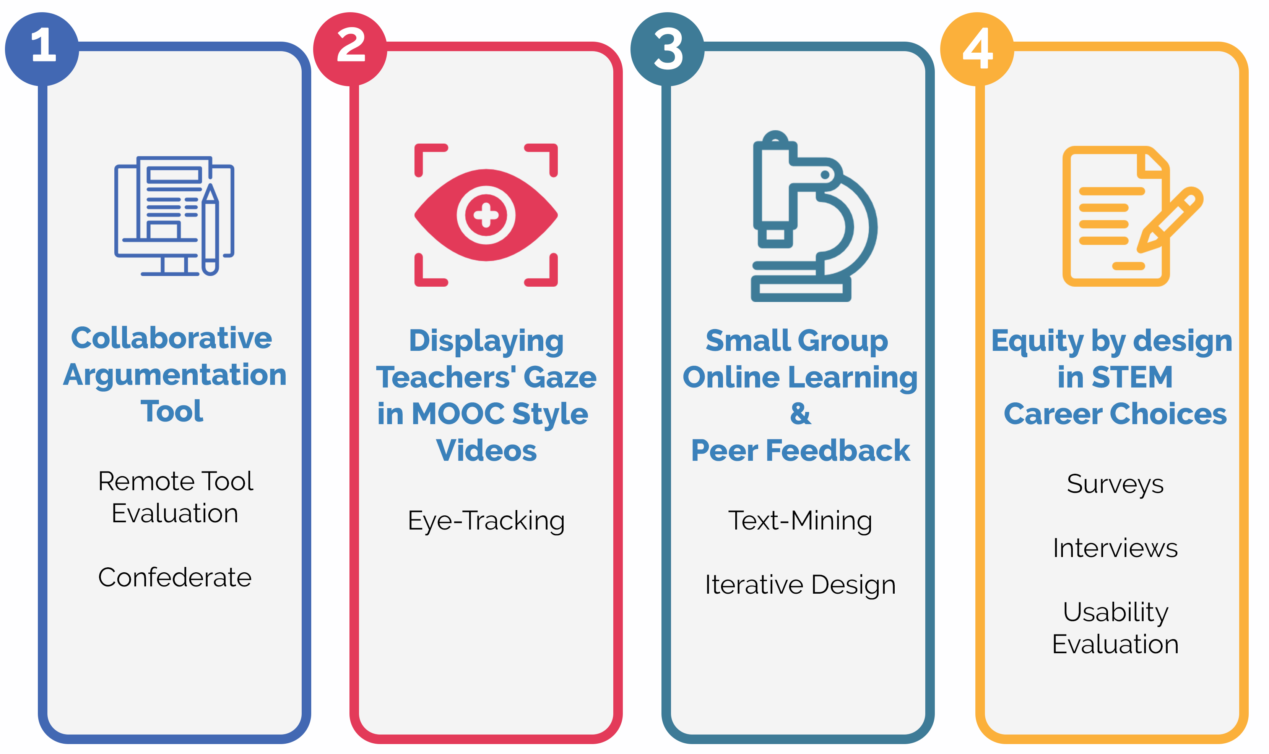
HCI in different ways

Slide 42
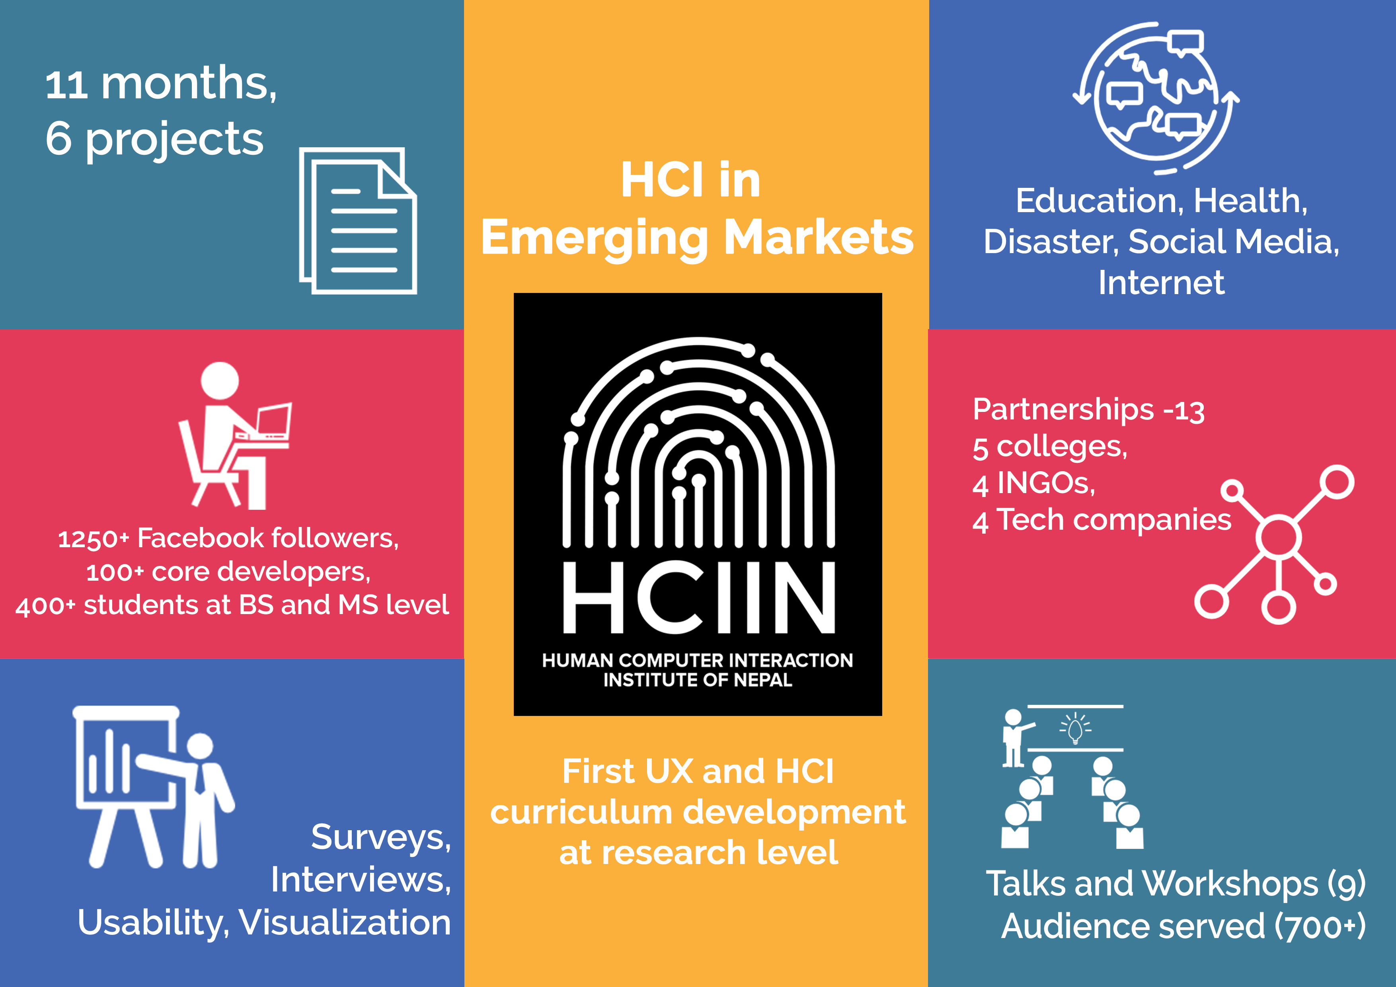
Founder
https://www.facebook.com/HCIIN/

Slide 43


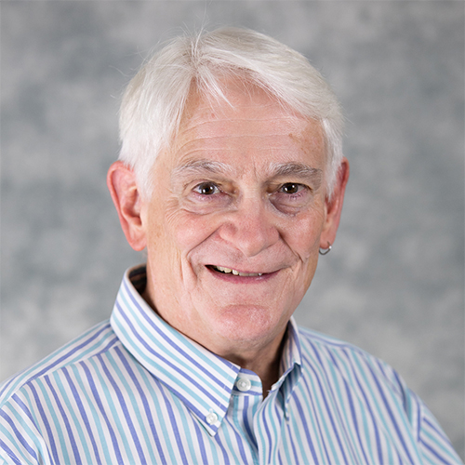
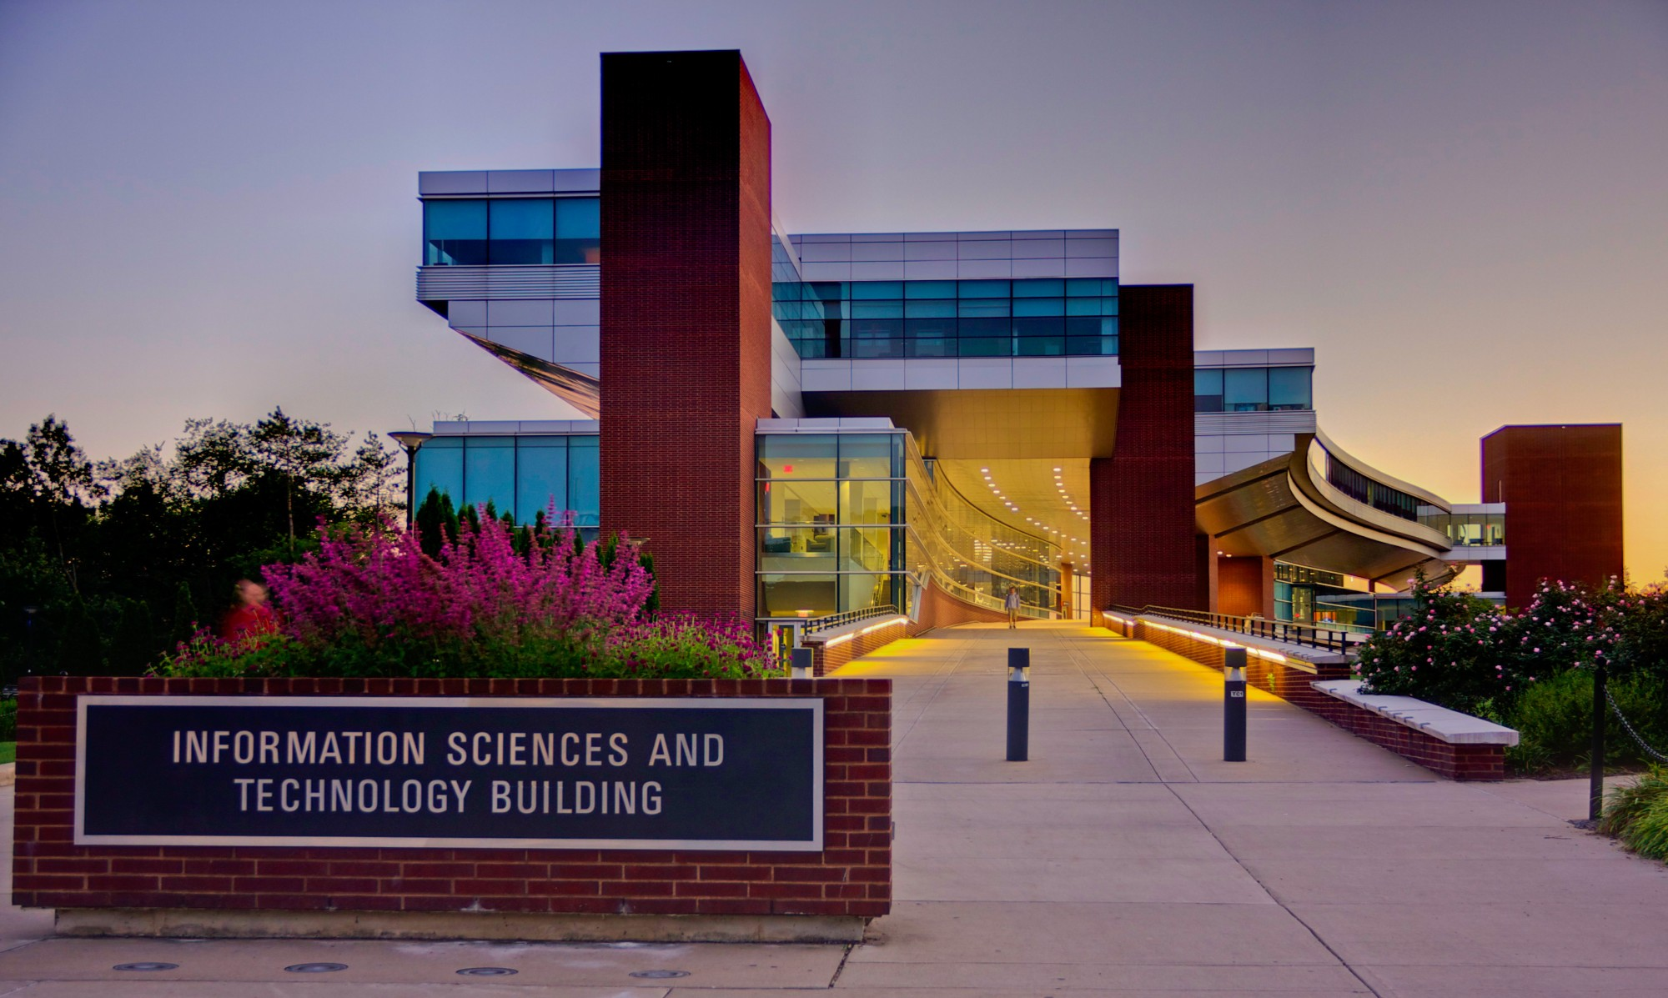

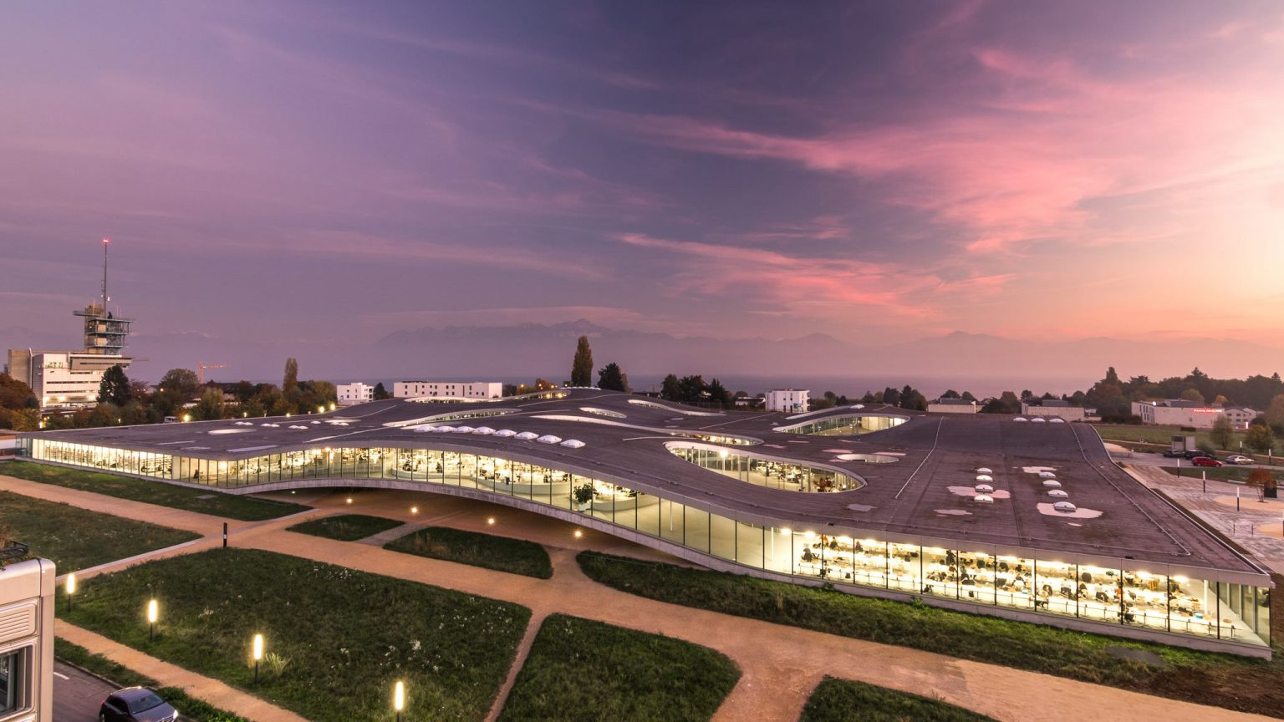
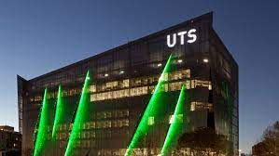

Slide 44

Disclaimer The views in this presentation are my own and don't necessarily represent the positions, strategies or opinions of Takeda, IBM, Harvard, and/or Penn State. I intend to attribute full citations to any images, quotes, texts, surveys that I have used to the original authors and publishers. If I’ve missed anything that is purely unintentional.
@bikalpaN
bikalpaBneupane@gmail.com
bneupane@fas. harvard.edu
Notes:
In NLP world recommendations become outdated over time with release of new NLP libraries and transformers almost every quarter. Instead of being overly prescriptive with our advice, we want to help you develop intuition for what matters when you make decisions about what to include in your tech stack.
We recognize that you probably have your own set of restrictions.

Slide 45
How do I identify use cases for ML or NLP?
The Problems
Too much time spent on manually/inefficiently parsing data
Inability to mine unstructured data quickly
Lack of skills in machine learning
The Result
Lost revenue
Missed opportunities
Increased costs
https://www.marketsandmarkets.com/Market-Reports/natural-language-processing-nlp-825.html
Notes:
One of the common questions I get asked is ‘how do I know when to implement the machine learning, in particular NLP’
What I’ve noticed is , the best bet on ML and NLP use cases tend to have some common characteristics:
• They seek operational or production efficiencies.
They also seek to automate redundant, data-heavy tasks or jobs that would allow humans to focus on human-suited tasks.
• and They seek insights for competitiave advantages, or personalizations to their customers and things around that nature. .

